Slide 1


UID-LINKED FACIAL AUTHENTICATION SYSTEM
Shivam Kumar, Shivam Kumar, Manali Jaiswal, Aanandita Thakur
School of Computer Application, Lovely Professional University
Date: 2025
Get Started

Slide 2

Individual Contributions by Students
Shivam Kumar designed and implemented the hardware setup and circuit connections.
Shivam Kumar (our second member) developed the facial recognition and UID-linking software.
Manali Jaiswal conducted the research and prepared the literature review for our paper.
Aanandita Thakur responsible for writing the documentation, formatting the research paper, and designing this presentation

Slide 3
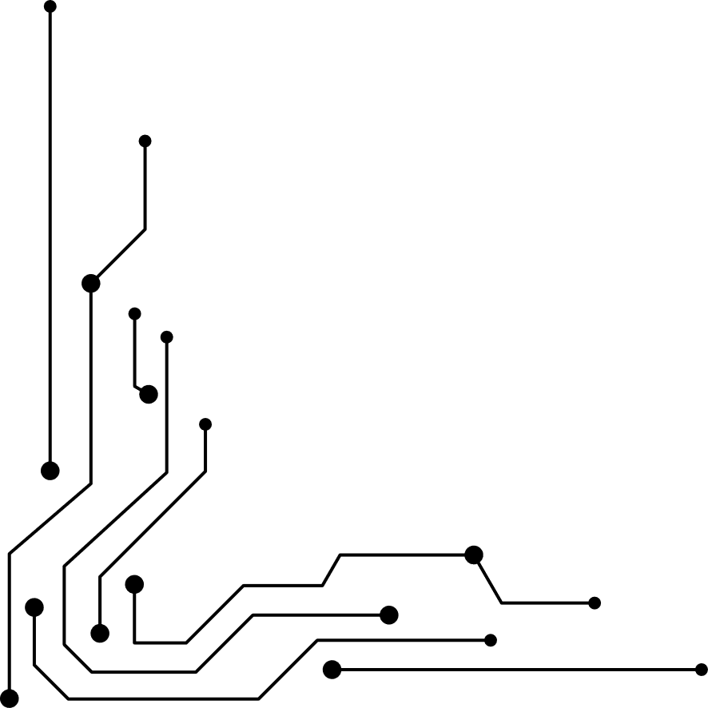



ABSTRACT
The UID-Linked Facial Authentication System (FIDAS) integrates RFID and face recognition for secure, real-time attendance logging. Triggered by RFID UID detection, it performs selective-frame facial verification using OpenCV to reduce computation. With 96% accuracy and 1.2s average response, the system ensures efficient, proxy-proof attendance tracking on low-cost ESP8266 hardware.

Slide 4

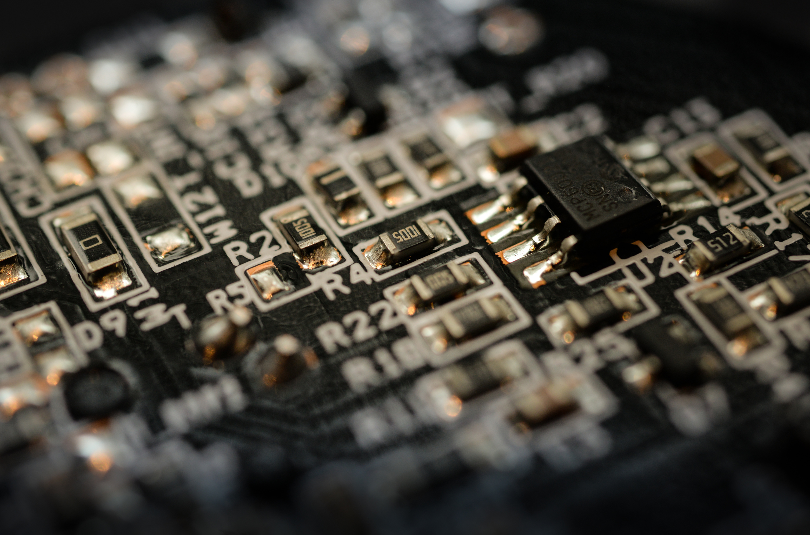
INTRODUCTION
Accurate, fast, and low-cost identity verification is essential for attendance and access control applications. Traditional RFID systems are quick but prone to misuse, while camera-only biometric systems are computationally heavy and environment-sensitive. The UID-Linked Facial Authentication System (FIDAS) combines RFID-triggered identification with selective-frame face recognition for reliable, real-time verification on low-cost hardware. In this system, an ESP8266 with RFID reader sends a user’s UID to a Python–OpenCV module, which captures a few frames and matches them with stored facial templates. Successful matches log attendance automatically, while mismatches trigger unauthorized access alerts. This selective-frame method minimizes computation and ensures accurate, efficient attendance tracking.

Slide 5
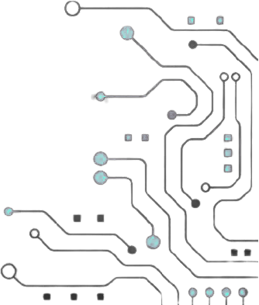


Literature Review
Past works combined RFID and biometric systems but lacked optimization for embedded devices. Selective-frame strategies improved accuracy with lower computation. Edge architectures like ESP8266 and ESP32 enable lightweight, real-time authentication for attendance systems.

Slide 6



PROBLEM FORMULATION
Existing RFID and facial systems are either insecure or computationally expensive. There’s a need for a hybrid solution combining RFID and selective-frame facial recognition for efficient, secure, real-time attendance.

Slide 7




Link each RFID UID to a corresponding facial template.
Reduce computation via selective-frame capture.
Log attendance in real-time to CSV/Excel.
Implement lightweight face recognition using OpenCV.
Evaluate accuracy, response time, and performance.
OBJECTIVES

Slide 8



FIDAS workflow:
1. RFID reader detects UID and sends it via ESP8266.
2. Host PC triggers camera to capture 3 selective frames.
3. OpenCV verifies face against UID-linked template.
4. Successful matches logged; unauthorized attempts flagged.
5. System balances accuracy, power, and processing efficiency.
PROPOSED WORK / METHODOLOGY

Slide 9
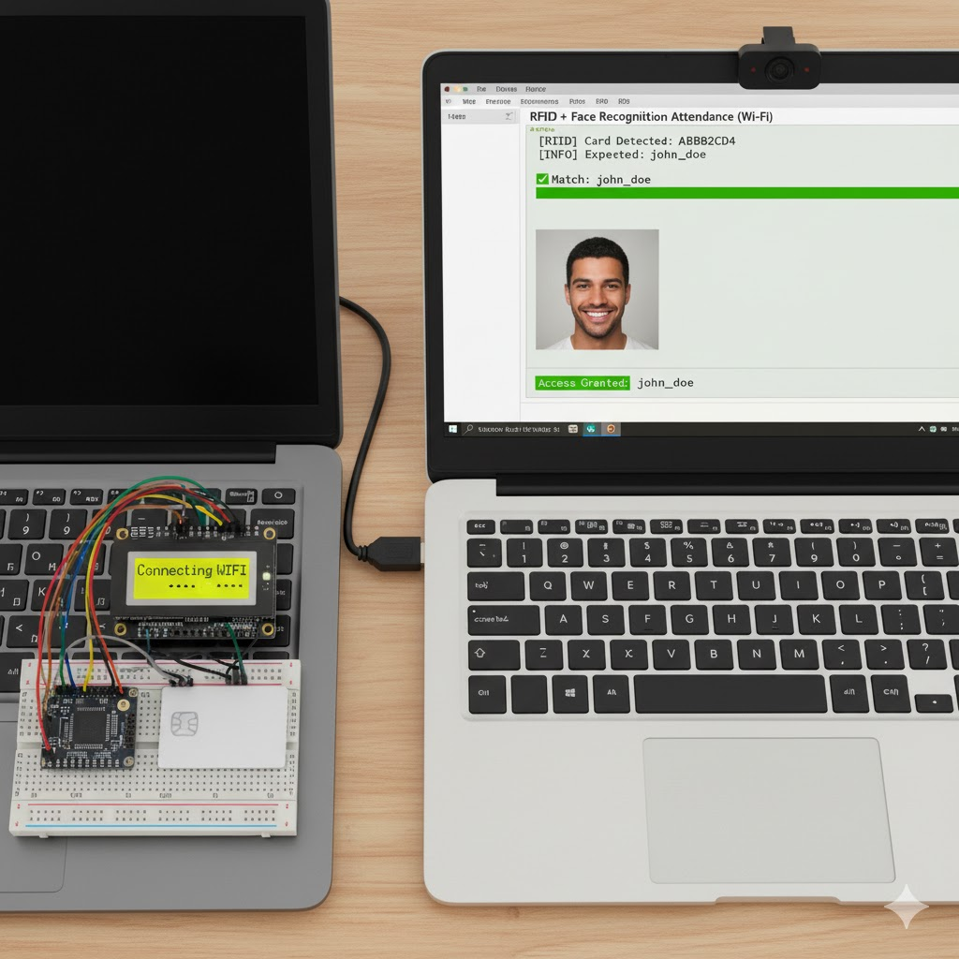
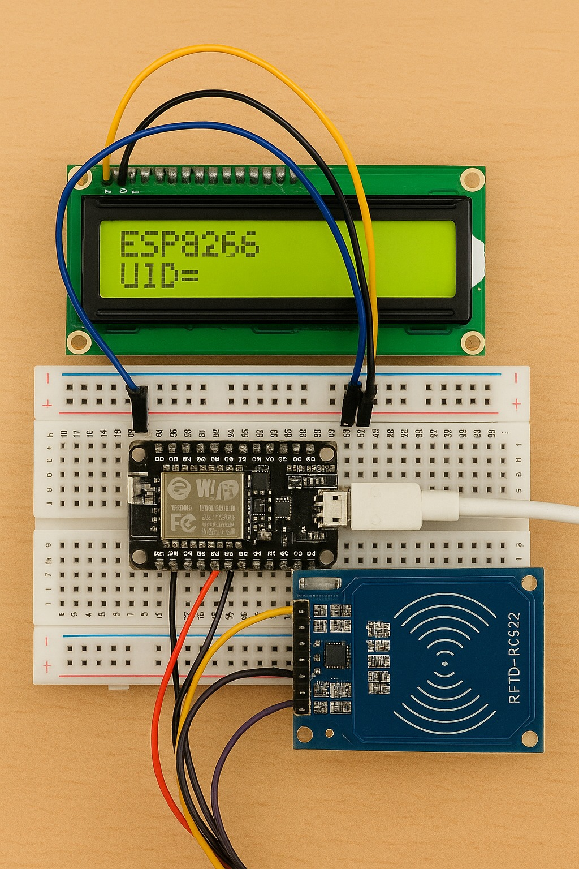
PROTOTYPE

Slide 10
SOURCE CODE OF PROJECT
Cpp code -https://github.com/Lumnic12/rfid_uid_retrive
Python code -https://github.com/Lumnic12/attend

Slide 11

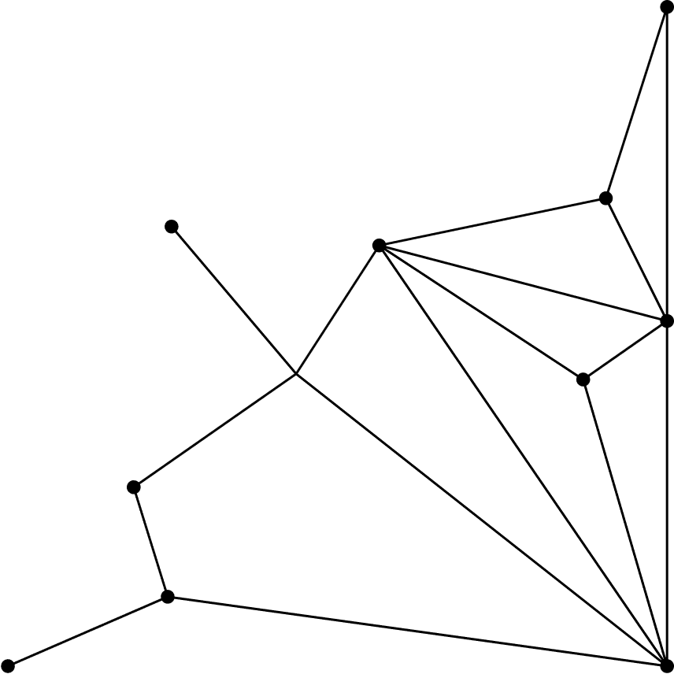

RESULTS / DISCUSSION
Authentication Accuracy: 96%
Average Response Time: 1.2 seconds
Reduced computation by ~70% vs. continuous video.
Reliable attendance logging and strong proxy prevention.
Performance drops only under poor lighting conditions.

Slide 12


CONCLUSION / FUTURE SCOPE
FIDAS successfully integrates RFID-based UID verification with selective-frame facial recognition for fast, secure attendance. It is efficient for embedded environments like classrooms or offices. Future work includes cloud integration, mobile extensions, and deep-learning-based recognition.

Slide 13
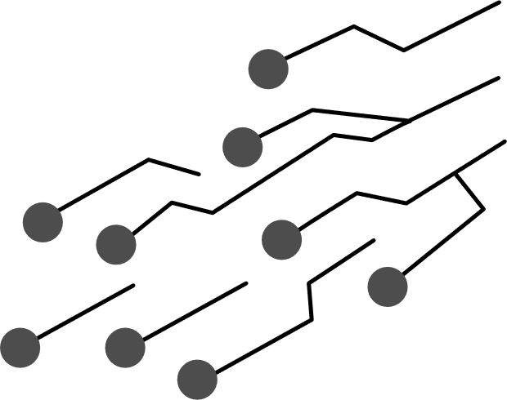

REFERENCES
1. Akbar, M.S. et al. (2018). RFID + Face Attendance System.
2. Kanna, P.V. et al. (2021). Smart Attendance using RFID & Face Recognition.
3. Baert, M. et al. (2021). Frame Selection in Face Recognition.
4. Budiharto, W. et al. (2022). Low-cost ESP32-CAM Attendance.
5. Mehendale, N. (2022). ESP32-CAM Object Recognition.

Slide 14
THANK YOU

